Slide 1
IPERF Suite
IPERF Suite – Peer-to-Peer TPUT testing automation
Notes:
Frames with faded pictures and text
(Intermediate)
To reproduce the picture effects on this slide, do the following:
On the Home tab, in the Slides group, click Layout, and then click Blank.
On the Insert tab, in the Images group, click Picture.
In the Insert Picture dialog box, select a picture and then click Insert.
Under Picture Tools, on the Format tab, in the Size group, click the Size and Position dialog box launcher. In the Format Picture dialog box, resize or crop the image so that the height is set to 3” and the width is set to 3”. To crop the picture, click Crop in the left pane, and in the right pane, under Crop position, enter values into the Height, Width, Left, and Top boxes. To resize the picture, click Size in the left pane, and in the right pane, under Size and rotate, enter values into the Height and Width boxes.
Select the picture. On the Home tab, in the Clipboard group, click the arrow under Copy, and then click Duplicate.
Move the duplicate picture to an area below the original picture.
Select the original picture. Under Picture Tools, on the Format tab, in the Adjust group, click Color, and then, under Recolor, click Grayscale (first row, second option from the left).
Also in the Adjust group, click Corrections, and then click Picture Corrections Options. In the Format Picture dialog box, click Picture Corrections in the left pane, and then in the right pane, do the following:
In the Brightness box, enter 55%.
In the Contrast box, enter -70%.
Select the duplicate picture. Under Picture Tools, on the Format tab, in the Size group, click the arrow under Crop, point to Crop to Shape, and then under Basic Shapes click Frame (second row, fourth option from the left). Click and drag the yellow diamond adjustment handle to increase or decrease frame width.
On the Insert tab, in the Images group, click Picture.
In the Insert Picture dialog box, select another picture and then click Insert.
Select the new picture. Under Picture Tools, on the Format tab, in the Size group, click the Size and Position dialog box launcher. In the Format Picture dialog box, resize or crop the image so that the height is set to 3” and the width is set to 3”. To crop the picture, click Crop in the left pane, and in the right pane, under Crop position, enter values into the Height, Width, Left, and Top boxes.
To resize the picture, click Size in the left pane, and in the right pane, under Size and rotate, enter values into the Height and Width boxes.
Select the new picture. On the Home tab, in the Clipboard group, click the arrow under Copy, and then click Duplicate.
Move the duplicate picture to an area below the original picture.
Select the original picture. Under Picture Tools, on the Format tab, in the Adjust group, click Color, and then, under Recolor, click Grayscale (first row, second option from the left).
Also in the Adjust group, click Corrections, and then click Picture Corrections Options. In the Format Picture dialog box, click Picture Corrections in the left pane, and then in the right pane, do the following:
In the Brightness box, enter 55%.
In the Contrast box, enter -70%.
Select the duplicate picture. Under Picture Tools, on the Format tab, in the Size group, click the arrow under Crop, point to Crop to Shape, and then under Basic Shapes click Frame (second row, fourth option from the left). Click and drag the yellow diamond adjustment handle to make the frame width the same as the first one.
Press and hold SHIFT and select both frames. On the Home tab, in the Drawing group, click Shape Effects, Point to Bevel, and then click 3-D Options. In the Format Shape dialog box, click 3-D Format in the left pane, and then do the following in the right pane under Bevel:
Click the button next to Top, and then under Bevel click Circle (first row, first option from the left).
Next to Top, in the Width box, enter 6 pt.
Next to Top, in the Height box, enter 6 pt.
Also in the Format Shape dialog box, click Shadow in the left pane, and then do the following in the right pane:
Click the button next to Presets, and then under Outer click Offset Bottom (first row, second option from the left).
In the Blur box, enter 30 pt.
In the Distance box, enter 18 pt.
Press and hold SHIFT and select one of the frames and the corresponding grayscale picture. On the Home tab, in the Drawing group, click Arrange, and then do the following to position the frame directly on top of the grayscale picture:
Point to Align, and then click Align Selected Objects.
Point to Align, and then click Align Center.
Point to Align, and then click Align Middle.
Click Group.
Repeat step 14 with the other frame and corresponding grayscale picture.
Select each group and drag them so they are next to each other at the desired position on the slide.
Press and hold SHIFT and select both groups. On the Home tab, in the Drawing group, click Arrange, point to Align, and then click Align Middle.
To reproduce the text effects on this slide, do the following:
On the Insert tab, in the Text group, click Text Box, and then on the slide, drag to draw the text box.
Enter text in the text box, select the text, and then on the Home tab, in the Font group, select Franklin Gothic Medium Cond from the Font list and then enter 30 in the Font Size box.
On the Home tab, in the Paragraph group, click Center to center the text on the slide.
Under Drawing Tools, on the Format tab, in the WordArt Styles group, click the arrow next to Text Fill, and then under Theme Colors click White, Background 1, Darker 50% (sixth row, first option from the left).
On the slide, drag the text box to position it inside one of the frames.
Repeat steps 1-5 to create text for the other frame.
To reproduce the horizontal line effects on this slide, do the following:
On the Home tab, in the Drawing group, click Shapes, and then under Lines click Line (first option from the left).
Press and hold SHIFT, and then on the slide, drag to draw a straight, horizontal line.
Select the line. Under Drawing Tools, on the Format tab, in the Size group, in the Shape Width box, enter 10”.
On the Home tab, in the bottom right corner of the Drawing group, click the Format Shape dialog box launcher. In the Format Shape dialog box, click Line Color in the left pane, and then do the following in the right pane:
Select Solid line.
Click the button next to Color, and then under Theme Colors click White, Background 1, Darker 35% (fifth row, first option from the left).
Also in the Format Shape dialog box, click Line Style in the left pane, and then in the right pane, in the Width box, enter 0.75 pt.
On the Home tab, in the Clipboard group, click the arrow under Copy, and then click Duplicate.
Press and hold SHIFT and select both lines on the slide.
On the Home tab, in the Drawing group, click Arrange, and then click Send to Back.
Drag both lines so that they are positioned behind the pictures and frames.
On the Home tab, in the Drawing group, click Arrange, point to Align, and then do the following:
Click Align to Slide.
Click Align Center.
To reproduce the background on this slide, do the following:
On the Design tab, in the Background group, click the arrow next to Background Styles, and click Style 5 (second row, first option from the left). (Note: If this action is taken in a PowerPoint presentation containing more than one slide, the background style will be applied to all of the slides.)

Slide 2
IPERF Suite – General functionality
IPERF Suite designed to simplify IPERF app usage for network traffic simulation.
IPERF Suite uses TELNET to connect to the related Windows and Linux Hosts.
IPERF Suite runs on Windows platform only.
IPERF Suite includes iManager and iRun applications.
iManager is Test configuration GUI.
iRun is Test control and execution GUI.
IPERF Suite supports TELNET connection to JWF attenuators.
IPERF Suite supports TELNET connection to Power Switch.
IPERF Suite supports TELNET connection to Fader.
Notes:
Frames with faded pictures and text
(Intermediate)
To reproduce the picture effects on this slide, do the following:
On the Home tab, in the Slides group, click Layout, and then click Blank.
On the Insert tab, in the Images group, click Picture.
In the Insert Picture dialog box, select a picture and then click Insert.
Under Picture Tools, on the Format tab, in the Size group, click the Size and Position dialog box launcher. In the Format Picture dialog box, resize or crop the image so that the height is set to 3” and the width is set to 3”. To crop the picture, click Crop in the left pane, and in the right pane, under Crop position, enter values into the Height, Width, Left, and Top boxes. To resize the picture, click Size in the left pane, and in the right pane, under Size and rotate, enter values into the Height and Width boxes.
Select the picture. On the Home tab, in the Clipboard group, click the arrow under Copy, and then click Duplicate.
Move the duplicate picture to an area below the original picture.
Select the original picture. Under Picture Tools, on the Format tab, in the Adjust group, click Color, and then, under Recolor, click Grayscale (first row, second option from the left).
Also in the Adjust group, click Corrections, and then click Picture Corrections Options. In the Format Picture dialog box, click Picture Corrections in the left pane, and then in the right pane, do the following:
In the Brightness box, enter 55%.
In the Contrast box, enter -70%.
Select the duplicate picture. Under Picture Tools, on the Format tab, in the Size group, click the arrow under Crop, point to Crop to Shape, and then under Basic Shapes click Frame (second row, fourth option from the left). Click and drag the yellow diamond adjustment handle to increase or decrease frame width.
On the Insert tab, in the Images group, click Picture.
In the Insert Picture dialog box, select another picture and then click Insert.
Select the new picture. Under Picture Tools, on the Format tab, in the Size group, click the Size and Position dialog box launcher. In the Format Picture dialog box, resize or crop the image so that the height is set to 3” and the width is set to 3”. To crop the picture, click Crop in the left pane, and in the right pane, under Crop position, enter values into the Height, Width, Left, and Top boxes.
To resize the picture, click Size in the left pane, and in the right pane, under Size and rotate, enter values into the Height and Width boxes.
Select the new picture. On the Home tab, in the Clipboard group, click the arrow under Copy, and then click Duplicate.
Move the duplicate picture to an area below the original picture.
Select the original picture. Under Picture Tools, on the Format tab, in the Adjust group, click Color, and then, under Recolor, click Grayscale (first row, second option from the left).
Also in the Adjust group, click Corrections, and then click Picture Corrections Options. In the Format Picture dialog box, click Picture Corrections in the left pane, and then in the right pane, do the following:
In the Brightness box, enter 55%.
In the Contrast box, enter -70%.
Select the duplicate picture. Under Picture Tools, on the Format tab, in the Size group, click the arrow under Crop, point to Crop to Shape, and then under Basic Shapes click Frame (second row, fourth option from the left). Click and drag the yellow diamond adjustment handle to make the frame width the same as the first one.
Press and hold SHIFT and select both frames. On the Home tab, in the Drawing group, click Shape Effects, Point to Bevel, and then click 3-D Options. In the Format Shape dialog box, click 3-D Format in the left pane, and then do the following in the right pane under Bevel:
Click the button next to Top, and then under Bevel click Circle (first row, first option from the left).
Next to Top, in the Width box, enter 6 pt.
Next to Top, in the Height box, enter 6 pt.
Also in the Format Shape dialog box, click Shadow in the left pane, and then do the following in the right pane:
Click the button next to Presets, and then under Outer click Offset Bottom (first row, second option from the left).
In the Blur box, enter 30 pt.
In the Distance box, enter 18 pt.
Press and hold SHIFT and select one of the frames and the corresponding grayscale picture. On the Home tab, in the Drawing group, click Arrange, and then do the following to position the frame directly on top of the grayscale picture:
Point to Align, and then click Align Selected Objects.
Point to Align, and then click Align Center.
Point to Align, and then click Align Middle.
Click Group.
Repeat step 14 with the other frame and corresponding grayscale picture.
Select each group and drag them so they are next to each other at the desired position on the slide.
Press and hold SHIFT and select both groups. On the Home tab, in the Drawing group, click Arrange, point to Align, and then click Align Middle.
To reproduce the text effects on this slide, do the following:
On the Insert tab, in the Text group, click Text Box, and then on the slide, drag to draw the text box.
Enter text in the text box, select the text, and then on the Home tab, in the Font group, select Franklin Gothic Medium Cond from the Font list and then enter 30 in the Font Size box.
On the Home tab, in the Paragraph group, click Center to center the text on the slide.
Under Drawing Tools, on the Format tab, in the WordArt Styles group, click the arrow next to Text Fill, and then under Theme Colors click White, Background 1, Darker 50% (sixth row, first option from the left).
On the slide, drag the text box to position it inside one of the frames.
Repeat steps 1-5 to create text for the other frame.
To reproduce the horizontal line effects on this slide, do the following:
On the Home tab, in the Drawing group, click Shapes, and then under Lines click Line (first option from the left).
Press and hold SHIFT, and then on the slide, drag to draw a straight, horizontal line.
Select the line. Under Drawing Tools, on the Format tab, in the Size group, in the Shape Width box, enter 10”.
On the Home tab, in the bottom right corner of the Drawing group, click the Format Shape dialog box launcher. In the Format Shape dialog box, click Line Color in the left pane, and then do the following in the right pane:
Select Solid line.
Click the button next to Color, and then under Theme Colors click White, Background 1, Darker 35% (fifth row, first option from the left).
Also in the Format Shape dialog box, click Line Style in the left pane, and then in the right pane, in the Width box, enter 0.75 pt.
On the Home tab, in the Clipboard group, click the arrow under Copy, and then click Duplicate.
Press and hold SHIFT and select both lines on the slide.
On the Home tab, in the Drawing group, click Arrange, and then click Send to Back.
Drag both lines so that they are positioned behind the pictures and frames.
On the Home tab, in the Drawing group, click Arrange, point to Align, and then do the following:
Click Align to Slide.
Click Align Center.
To reproduce the background on this slide, do the following:
On the Design tab, in the Background group, click the arrow next to Background Styles, and click Style 5 (second row, first option from the left). (Note: If this action is taken in a PowerPoint presentation containing more than one slide, the background style will be applied to all of the slides.)

Slide 3

IPERF Suite – E2E TPUT testing application
Simplified Wireless Network Testbed with IPERF Suite PC running TELNET sessions to perform E2E TPUT testing against increasing RF Path Loss.
Notes:
Frames with faded pictures and text
(Intermediate)
To reproduce the picture effects on this slide, do the following:
On the Home tab, in the Slides group, click Layout, and then click Blank.
On the Insert tab, in the Images group, click Picture.
In the Insert Picture dialog box, select a picture and then click Insert.
Under Picture Tools, on the Format tab, in the Size group, click the Size and Position dialog box launcher. In the Format Picture dialog box, resize or crop the image so that the height is set to 3” and the width is set to 3”. To crop the picture, click Crop in the left pane, and in the right pane, under Crop position, enter values into the Height, Width, Left, and Top boxes. To resize the picture, click Size in the left pane, and in the right pane, under Size and rotate, enter values into the Height and Width boxes.
Select the picture. On the Home tab, in the Clipboard group, click the arrow under Copy, and then click Duplicate.
Move the duplicate picture to an area below the original picture.
Select the original picture. Under Picture Tools, on the Format tab, in the Adjust group, click Color, and then, under Recolor, click Grayscale (first row, second option from the left).
Also in the Adjust group, click Corrections, and then click Picture Corrections Options. In the Format Picture dialog box, click Picture Corrections in the left pane, and then in the right pane, do the following:
In the Brightness box, enter 55%.
In the Contrast box, enter -70%.
Select the duplicate picture. Under Picture Tools, on the Format tab, in the Size group, click the arrow under Crop, point to Crop to Shape, and then under Basic Shapes click Frame (second row, fourth option from the left). Click and drag the yellow diamond adjustment handle to increase or decrease frame width.
On the Insert tab, in the Images group, click Picture.
In the Insert Picture dialog box, select another picture and then click Insert.
Select the new picture. Under Picture Tools, on the Format tab, in the Size group, click the Size and Position dialog box launcher. In the Format Picture dialog box, resize or crop the image so that the height is set to 3” and the width is set to 3”. To crop the picture, click Crop in the left pane, and in the right pane, under Crop position, enter values into the Height, Width, Left, and Top boxes.
To resize the picture, click Size in the left pane, and in the right pane, under Size and rotate, enter values into the Height and Width boxes.
Select the new picture. On the Home tab, in the Clipboard group, click the arrow under Copy, and then click Duplicate.
Move the duplicate picture to an area below the original picture.
Select the original picture. Under Picture Tools, on the Format tab, in the Adjust group, click Color, and then, under Recolor, click Grayscale (first row, second option from the left).
Also in the Adjust group, click Corrections, and then click Picture Corrections Options. In the Format Picture dialog box, click Picture Corrections in the left pane, and then in the right pane, do the following:
In the Brightness box, enter 55%.
In the Contrast box, enter -70%.
Select the duplicate picture. Under Picture Tools, on the Format tab, in the Size group, click the arrow under Crop, point to Crop to Shape, and then under Basic Shapes click Frame (second row, fourth option from the left). Click and drag the yellow diamond adjustment handle to make the frame width the same as the first one.
Press and hold SHIFT and select both frames. On the Home tab, in the Drawing group, click Shape Effects, Point to Bevel, and then click 3-D Options. In the Format Shape dialog box, click 3-D Format in the left pane, and then do the following in the right pane under Bevel:
Click the button next to Top, and then under Bevel click Circle (first row, first option from the left).
Next to Top, in the Width box, enter 6 pt.
Next to Top, in the Height box, enter 6 pt.
Also in the Format Shape dialog box, click Shadow in the left pane, and then do the following in the right pane:
Click the button next to Presets, and then under Outer click Offset Bottom (first row, second option from the left).
In the Blur box, enter 30 pt.
In the Distance box, enter 18 pt.
Press and hold SHIFT and select one of the frames and the corresponding grayscale picture. On the Home tab, in the Drawing group, click Arrange, and then do the following to position the frame directly on top of the grayscale picture:
Point to Align, and then click Align Selected Objects.
Point to Align, and then click Align Center.
Point to Align, and then click Align Middle.
Click Group.
Repeat step 14 with the other frame and corresponding grayscale picture.
Select each group and drag them so they are next to each other at the desired position on the slide.
Press and hold SHIFT and select both groups. On the Home tab, in the Drawing group, click Arrange, point to Align, and then click Align Middle.
To reproduce the text effects on this slide, do the following:
On the Insert tab, in the Text group, click Text Box, and then on the slide, drag to draw the text box.
Enter text in the text box, select the text, and then on the Home tab, in the Font group, select Franklin Gothic Medium Cond from the Font list and then enter 30 in the Font Size box.
On the Home tab, in the Paragraph group, click Center to center the text on the slide.
Under Drawing Tools, on the Format tab, in the WordArt Styles group, click the arrow next to Text Fill, and then under Theme Colors click White, Background 1, Darker 50% (sixth row, first option from the left).
On the slide, drag the text box to position it inside one of the frames.
Repeat steps 1-5 to create text for the other frame.
To reproduce the horizontal line effects on this slide, do the following:
On the Home tab, in the Drawing group, click Shapes, and then under Lines click Line (first option from the left).
Press and hold SHIFT, and then on the slide, drag to draw a straight, horizontal line.
Select the line. Under Drawing Tools, on the Format tab, in the Size group, in the Shape Width box, enter 10”.
On the Home tab, in the bottom right corner of the Drawing group, click the Format Shape dialog box launcher. In the Format Shape dialog box, click Line Color in the left pane, and then do the following in the right pane:
Select Solid line.
Click the button next to Color, and then under Theme Colors click White, Background 1, Darker 35% (fifth row, first option from the left).
Also in the Format Shape dialog box, click Line Style in the left pane, and then in the right pane, in the Width box, enter 0.75 pt.
On the Home tab, in the Clipboard group, click the arrow under Copy, and then click Duplicate.
Press and hold SHIFT and select both lines on the slide.
On the Home tab, in the Drawing group, click Arrange, and then click Send to Back.
Drag both lines so that they are positioned behind the pictures and frames.
On the Home tab, in the Drawing group, click Arrange, point to Align, and then do the following:
Click Align to Slide.
Click Align Center.
To reproduce the background on this slide, do the following:
On the Design tab, in the Background group, click the arrow next to Background Styles, and click Style 5 (second row, first option from the left). (Note: If this action is taken in a PowerPoint presentation containing more than one slide, the background style will be applied to all of the slides.)

Slide 4
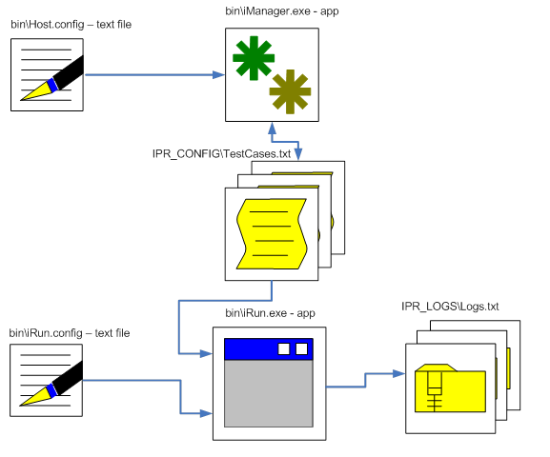
IPERF Suite – Functional workflow
Basic functional IPERF Suite workflow and files used in the process.
iManager Input: Host.config, TestCases. Output: TestCases.
iRun Input: iRun.config, TestCases. Output: Logs.
Notes:
Frames with faded pictures and text
(Intermediate)
To reproduce the picture effects on this slide, do the following:
On the Home tab, in the Slides group, click Layout, and then click Blank.
On the Insert tab, in the Images group, click Picture.
In the Insert Picture dialog box, select a picture and then click Insert.
Under Picture Tools, on the Format tab, in the Size group, click the Size and Position dialog box launcher. In the Format Picture dialog box, resize or crop the image so that the height is set to 3” and the width is set to 3”. To crop the picture, click Crop in the left pane, and in the right pane, under Crop position, enter values into the Height, Width, Left, and Top boxes. To resize the picture, click Size in the left pane, and in the right pane, under Size and rotate, enter values into the Height and Width boxes.
Select the picture. On the Home tab, in the Clipboard group, click the arrow under Copy, and then click Duplicate.
Move the duplicate picture to an area below the original picture.
Select the original picture. Under Picture Tools, on the Format tab, in the Adjust group, click Color, and then, under Recolor, click Grayscale (first row, second option from the left).
Also in the Adjust group, click Corrections, and then click Picture Corrections Options. In the Format Picture dialog box, click Picture Corrections in the left pane, and then in the right pane, do the following:
In the Brightness box, enter 55%.
In the Contrast box, enter -70%.
Select the duplicate picture. Under Picture Tools, on the Format tab, in the Size group, click the arrow under Crop, point to Crop to Shape, and then under Basic Shapes click Frame (second row, fourth option from the left). Click and drag the yellow diamond adjustment handle to increase or decrease frame width.
On the Insert tab, in the Images group, click Picture.
In the Insert Picture dialog box, select another picture and then click Insert.
Select the new picture. Under Picture Tools, on the Format tab, in the Size group, click the Size and Position dialog box launcher. In the Format Picture dialog box, resize or crop the image so that the height is set to 3” and the width is set to 3”. To crop the picture, click Crop in the left pane, and in the right pane, under Crop position, enter values into the Height, Width, Left, and Top boxes.
To resize the picture, click Size in the left pane, and in the right pane, under Size and rotate, enter values into the Height and Width boxes.
Select the new picture. On the Home tab, in the Clipboard group, click the arrow under Copy, and then click Duplicate.
Move the duplicate picture to an area below the original picture.
Select the original picture. Under Picture Tools, on the Format tab, in the Adjust group, click Color, and then, under Recolor, click Grayscale (first row, second option from the left).
Also in the Adjust group, click Corrections, and then click Picture Corrections Options. In the Format Picture dialog box, click Picture Corrections in the left pane, and then in the right pane, do the following:
In the Brightness box, enter 55%.
In the Contrast box, enter -70%.
Select the duplicate picture. Under Picture Tools, on the Format tab, in the Size group, click the arrow under Crop, point to Crop to Shape, and then under Basic Shapes click Frame (second row, fourth option from the left). Click and drag the yellow diamond adjustment handle to make the frame width the same as the first one.
Press and hold SHIFT and select both frames. On the Home tab, in the Drawing group, click Shape Effects, Point to Bevel, and then click 3-D Options. In the Format Shape dialog box, click 3-D Format in the left pane, and then do the following in the right pane under Bevel:
Click the button next to Top, and then under Bevel click Circle (first row, first option from the left).
Next to Top, in the Width box, enter 6 pt.
Next to Top, in the Height box, enter 6 pt.
Also in the Format Shape dialog box, click Shadow in the left pane, and then do the following in the right pane:
Click the button next to Presets, and then under Outer click Offset Bottom (first row, second option from the left).
In the Blur box, enter 30 pt.
In the Distance box, enter 18 pt.
Press and hold SHIFT and select one of the frames and the corresponding grayscale picture. On the Home tab, in the Drawing group, click Arrange, and then do the following to position the frame directly on top of the grayscale picture:
Point to Align, and then click Align Selected Objects.
Point to Align, and then click Align Center.
Point to Align, and then click Align Middle.
Click Group.
Repeat step 14 with the other frame and corresponding grayscale picture.
Select each group and drag them so they are next to each other at the desired position on the slide.
Press and hold SHIFT and select both groups. On the Home tab, in the Drawing group, click Arrange, point to Align, and then click Align Middle.
To reproduce the text effects on this slide, do the following:
On the Insert tab, in the Text group, click Text Box, and then on the slide, drag to draw the text box.
Enter text in the text box, select the text, and then on the Home tab, in the Font group, select Franklin Gothic Medium Cond from the Font list and then enter 30 in the Font Size box.
On the Home tab, in the Paragraph group, click Center to center the text on the slide.
Under Drawing Tools, on the Format tab, in the WordArt Styles group, click the arrow next to Text Fill, and then under Theme Colors click White, Background 1, Darker 50% (sixth row, first option from the left).
On the slide, drag the text box to position it inside one of the frames.
Repeat steps 1-5 to create text for the other frame.
To reproduce the horizontal line effects on this slide, do the following:
On the Home tab, in the Drawing group, click Shapes, and then under Lines click Line (first option from the left).
Press and hold SHIFT, and then on the slide, drag to draw a straight, horizontal line.
Select the line. Under Drawing Tools, on the Format tab, in the Size group, in the Shape Width box, enter 10”.
On the Home tab, in the bottom right corner of the Drawing group, click the Format Shape dialog box launcher. In the Format Shape dialog box, click Line Color in the left pane, and then do the following in the right pane:
Select Solid line.
Click the button next to Color, and then under Theme Colors click White, Background 1, Darker 35% (fifth row, first option from the left).
Also in the Format Shape dialog box, click Line Style in the left pane, and then in the right pane, in the Width box, enter 0.75 pt.
On the Home tab, in the Clipboard group, click the arrow under Copy, and then click Duplicate.
Press and hold SHIFT and select both lines on the slide.
On the Home tab, in the Drawing group, click Arrange, and then click Send to Back.
Drag both lines so that they are positioned behind the pictures and frames.
On the Home tab, in the Drawing group, click Arrange, point to Align, and then do the following:
Click Align to Slide.
Click Align Center.
To reproduce the background on this slide, do the following:
On the Design tab, in the Background group, click the arrow next to Background Styles, and click Style 5 (second row, first option from the left). (Note: If this action is taken in a PowerPoint presentation containing more than one slide, the background style will be applied to all of the slides.)

Slide 5

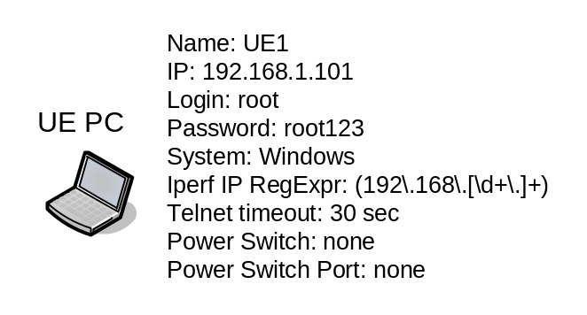
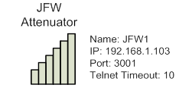

IPERF Suite – Sample of Host.config file syntax
epc_server_node=IPERF1,192.168.1.102,root,root123,Lin,192.168.2.10,30
ue_pc_node=UE1,192.168.1.101,root,root123,Win,(192\.168\.[\d+\.]+),30,none,none
jfw_node=JFW1,192.168.1.103,3001,10
Notes:
Frames with faded pictures and text
(Intermediate)
To reproduce the picture effects on this slide, do the following:
On the Home tab, in the Slides group, click Layout, and then click Blank.
On the Insert tab, in the Images group, click Picture.
In the Insert Picture dialog box, select a picture and then click Insert.
Under Picture Tools, on the Format tab, in the Size group, click the Size and Position dialog box launcher. In the Format Picture dialog box, resize or crop the image so that the height is set to 3” and the width is set to 3”. To crop the picture, click Crop in the left pane, and in the right pane, under Crop position, enter values into the Height, Width, Left, and Top boxes. To resize the picture, click Size in the left pane, and in the right pane, under Size and rotate, enter values into the Height and Width boxes.
Select the picture. On the Home tab, in the Clipboard group, click the arrow under Copy, and then click Duplicate.
Move the duplicate picture to an area below the original picture.
Select the original picture. Under Picture Tools, on the Format tab, in the Adjust group, click Color, and then, under Recolor, click Grayscale (first row, second option from the left).
Also in the Adjust group, click Corrections, and then click Picture Corrections Options. In the Format Picture dialog box, click Picture Corrections in the left pane, and then in the right pane, do the following:
In the Brightness box, enter 55%.
In the Contrast box, enter -70%.
Select the duplicate picture. Under Picture Tools, on the Format tab, in the Size group, click the arrow under Crop, point to Crop to Shape, and then under Basic Shapes click Frame (second row, fourth option from the left). Click and drag the yellow diamond adjustment handle to increase or decrease frame width.
On the Insert tab, in the Images group, click Picture.
In the Insert Picture dialog box, select another picture and then click Insert.
Select the new picture. Under Picture Tools, on the Format tab, in the Size group, click the Size and Position dialog box launcher. In the Format Picture dialog box, resize or crop the image so that the height is set to 3” and the width is set to 3”. To crop the picture, click Crop in the left pane, and in the right pane, under Crop position, enter values into the Height, Width, Left, and Top boxes.
To resize the picture, click Size in the left pane, and in the right pane, under Size and rotate, enter values into the Height and Width boxes.
Select the new picture. On the Home tab, in the Clipboard group, click the arrow under Copy, and then click Duplicate.
Move the duplicate picture to an area below the original picture.
Select the original picture. Under Picture Tools, on the Format tab, in the Adjust group, click Color, and then, under Recolor, click Grayscale (first row, second option from the left).
Also in the Adjust group, click Corrections, and then click Picture Corrections Options. In the Format Picture dialog box, click Picture Corrections in the left pane, and then in the right pane, do the following:
In the Brightness box, enter 55%.
In the Contrast box, enter -70%.
Select the duplicate picture. Under Picture Tools, on the Format tab, in the Size group, click the arrow under Crop, point to Crop to Shape, and then under Basic Shapes click Frame (second row, fourth option from the left). Click and drag the yellow diamond adjustment handle to make the frame width the same as the first one.
Press and hold SHIFT and select both frames. On the Home tab, in the Drawing group, click Shape Effects, Point to Bevel, and then click 3-D Options. In the Format Shape dialog box, click 3-D Format in the left pane, and then do the following in the right pane under Bevel:
Click the button next to Top, and then under Bevel click Circle (first row, first option from the left).
Next to Top, in the Width box, enter 6 pt.
Next to Top, in the Height box, enter 6 pt.
Also in the Format Shape dialog box, click Shadow in the left pane, and then do the following in the right pane:
Click the button next to Presets, and then under Outer click Offset Bottom (first row, second option from the left).
In the Blur box, enter 30 pt.
In the Distance box, enter 18 pt.
Press and hold SHIFT and select one of the frames and the corresponding grayscale picture. On the Home tab, in the Drawing group, click Arrange, and then do the following to position the frame directly on top of the grayscale picture:
Point to Align, and then click Align Selected Objects.
Point to Align, and then click Align Center.
Point to Align, and then click Align Middle.
Click Group.
Repeat step 14 with the other frame and corresponding grayscale picture.
Select each group and drag them so they are next to each other at the desired position on the slide.
Press and hold SHIFT and select both groups. On the Home tab, in the Drawing group, click Arrange, point to Align, and then click Align Middle.
To reproduce the text effects on this slide, do the following:
On the Insert tab, in the Text group, click Text Box, and then on the slide, drag to draw the text box.
Enter text in the text box, select the text, and then on the Home tab, in the Font group, select Franklin Gothic Medium Cond from the Font list and then enter 30 in the Font Size box.
On the Home tab, in the Paragraph group, click Center to center the text on the slide.
Under Drawing Tools, on the Format tab, in the WordArt Styles group, click the arrow next to Text Fill, and then under Theme Colors click White, Background 1, Darker 50% (sixth row, first option from the left).
On the slide, drag the text box to position it inside one of the frames.
Repeat steps 1-5 to create text for the other frame.
To reproduce the horizontal line effects on this slide, do the following:
On the Home tab, in the Drawing group, click Shapes, and then under Lines click Line (first option from the left).
Press and hold SHIFT, and then on the slide, drag to draw a straight, horizontal line.
Select the line. Under Drawing Tools, on the Format tab, in the Size group, in the Shape Width box, enter 10”.
On the Home tab, in the bottom right corner of the Drawing group, click the Format Shape dialog box launcher. In the Format Shape dialog box, click Line Color in the left pane, and then do the following in the right pane:
Select Solid line.
Click the button next to Color, and then under Theme Colors click White, Background 1, Darker 35% (fifth row, first option from the left).
Also in the Format Shape dialog box, click Line Style in the left pane, and then in the right pane, in the Width box, enter 0.75 pt.
On the Home tab, in the Clipboard group, click the arrow under Copy, and then click Duplicate.
Press and hold SHIFT and select both lines on the slide.
On the Home tab, in the Drawing group, click Arrange, and then click Send to Back.
Drag both lines so that they are positioned behind the pictures and frames.
On the Home tab, in the Drawing group, click Arrange, point to Align, and then do the following:
Click Align to Slide.
Click Align Center.
To reproduce the background on this slide, do the following:
On the Design tab, in the Background group, click the arrow next to Background Styles, and click Style 5 (second row, first option from the left). (Note: If this action is taken in a PowerPoint presentation containing more than one slide, the background style will be applied to all of the slides.)

Slide 6
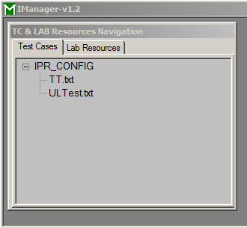
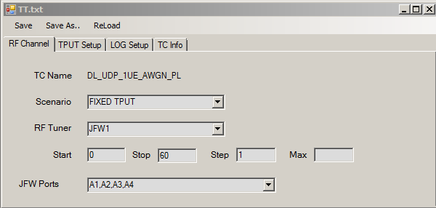
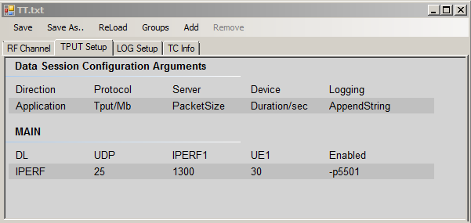
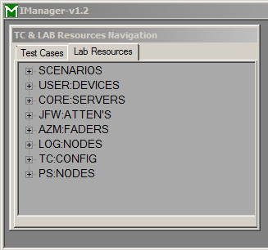

IPERF Suite – Usage of iManager.exe GUI
Double-Click on TT.txt
Click on TPUT Setup Tab
TestCases browsing Tab
Click Save
Lab resources browsing Tab Parses Host.config file
TestCase TT.txt ready for execution
Notes:
Frames with faded pictures and text
(Intermediate)
To reproduce the picture effects on this slide, do the following:
On the Home tab, in the Slides group, click Layout, and then click Blank.
On the Insert tab, in the Images group, click Picture.
In the Insert Picture dialog box, select a picture and then click Insert.
Under Picture Tools, on the Format tab, in the Size group, click the Size and Position dialog box launcher. In the Format Picture dialog box, resize or crop the image so that the height is set to 3” and the width is set to 3”. To crop the picture, click Crop in the left pane, and in the right pane, under Crop position, enter values into the Height, Width, Left, and Top boxes. To resize the picture, click Size in the left pane, and in the right pane, under Size and rotate, enter values into the Height and Width boxes.
Select the picture. On the Home tab, in the Clipboard group, click the arrow under Copy, and then click Duplicate.
Move the duplicate picture to an area below the original picture.
Select the original picture. Under Picture Tools, on the Format tab, in the Adjust group, click Color, and then, under Recolor, click Grayscale (first row, second option from the left).
Also in the Adjust group, click Corrections, and then click Picture Corrections Options. In the Format Picture dialog box, click Picture Corrections in the left pane, and then in the right pane, do the following:
In the Brightness box, enter 55%.
In the Contrast box, enter -70%.
Select the duplicate picture. Under Picture Tools, on the Format tab, in the Size group, click the arrow under Crop, point to Crop to Shape, and then under Basic Shapes click Frame (second row, fourth option from the left). Click and drag the yellow diamond adjustment handle to increase or decrease frame width.
On the Insert tab, in the Images group, click Picture.
In the Insert Picture dialog box, select another picture and then click Insert.
Select the new picture. Under Picture Tools, on the Format tab, in the Size group, click the Size and Position dialog box launcher. In the Format Picture dialog box, resize or crop the image so that the height is set to 3” and the width is set to 3”. To crop the picture, click Crop in the left pane, and in the right pane, under Crop position, enter values into the Height, Width, Left, and Top boxes.
To resize the picture, click Size in the left pane, and in the right pane, under Size and rotate, enter values into the Height and Width boxes.
Select the new picture. On the Home tab, in the Clipboard group, click the arrow under Copy, and then click Duplicate.
Move the duplicate picture to an area below the original picture.
Select the original picture. Under Picture Tools, on the Format tab, in the Adjust group, click Color, and then, under Recolor, click Grayscale (first row, second option from the left).
Also in the Adjust group, click Corrections, and then click Picture Corrections Options. In the Format Picture dialog box, click Picture Corrections in the left pane, and then in the right pane, do the following:
In the Brightness box, enter 55%.
In the Contrast box, enter -70%.
Select the duplicate picture. Under Picture Tools, on the Format tab, in the Size group, click the arrow under Crop, point to Crop to Shape, and then under Basic Shapes click Frame (second row, fourth option from the left). Click and drag the yellow diamond adjustment handle to make the frame width the same as the first one.
Press and hold SHIFT and select both frames. On the Home tab, in the Drawing group, click Shape Effects, Point to Bevel, and then click 3-D Options. In the Format Shape dialog box, click 3-D Format in the left pane, and then do the following in the right pane under Bevel:
Click the button next to Top, and then under Bevel click Circle (first row, first option from the left).
Next to Top, in the Width box, enter 6 pt.
Next to Top, in the Height box, enter 6 pt.
Also in the Format Shape dialog box, click Shadow in the left pane, and then do the following in the right pane:
Click the button next to Presets, and then under Outer click Offset Bottom (first row, second option from the left).
In the Blur box, enter 30 pt.
In the Distance box, enter 18 pt.
Press and hold SHIFT and select one of the frames and the corresponding grayscale picture. On the Home tab, in the Drawing group, click Arrange, and then do the following to position the frame directly on top of the grayscale picture:
Point to Align, and then click Align Selected Objects.
Point to Align, and then click Align Center.
Point to Align, and then click Align Middle.
Click Group.
Repeat step 14 with the other frame and corresponding grayscale picture.
Select each group and drag them so they are next to each other at the desired position on the slide.
Press and hold SHIFT and select both groups. On the Home tab, in the Drawing group, click Arrange, point to Align, and then click Align Middle.
To reproduce the text effects on this slide, do the following:
On the Insert tab, in the Text group, click Text Box, and then on the slide, drag to draw the text box.
Enter text in the text box, select the text, and then on the Home tab, in the Font group, select Franklin Gothic Medium Cond from the Font list and then enter 30 in the Font Size box.
On the Home tab, in the Paragraph group, click Center to center the text on the slide.
Under Drawing Tools, on the Format tab, in the WordArt Styles group, click the arrow next to Text Fill, and then under Theme Colors click White, Background 1, Darker 50% (sixth row, first option from the left).
On the slide, drag the text box to position it inside one of the frames.
Repeat steps 1-5 to create text for the other frame.
To reproduce the horizontal line effects on this slide, do the following:
On the Home tab, in the Drawing group, click Shapes, and then under Lines click Line (first option from the left).
Press and hold SHIFT, and then on the slide, drag to draw a straight, horizontal line.
Select the line. Under Drawing Tools, on the Format tab, in the Size group, in the Shape Width box, enter 10”.
On the Home tab, in the bottom right corner of the Drawing group, click the Format Shape dialog box launcher. In the Format Shape dialog box, click Line Color in the left pane, and then do the following in the right pane:
Select Solid line.
Click the button next to Color, and then under Theme Colors click White, Background 1, Darker 35% (fifth row, first option from the left).
Also in the Format Shape dialog box, click Line Style in the left pane, and then in the right pane, in the Width box, enter 0.75 pt.
On the Home tab, in the Clipboard group, click the arrow under Copy, and then click Duplicate.
Press and hold SHIFT and select both lines on the slide.
On the Home tab, in the Drawing group, click Arrange, and then click Send to Back.
Drag both lines so that they are positioned behind the pictures and frames.
On the Home tab, in the Drawing group, click Arrange, point to Align, and then do the following:
Click Align to Slide.
Click Align Center.
To reproduce the background on this slide, do the following:
On the Design tab, in the Background group, click the arrow next to Background Styles, and click Style 5 (second row, first option from the left). (Note: If this action is taken in a PowerPoint presentation containing more than one slide, the background style will be applied to all of the slides.)

Slide 7
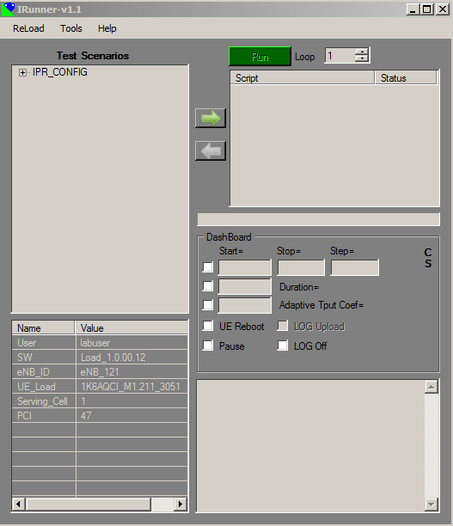
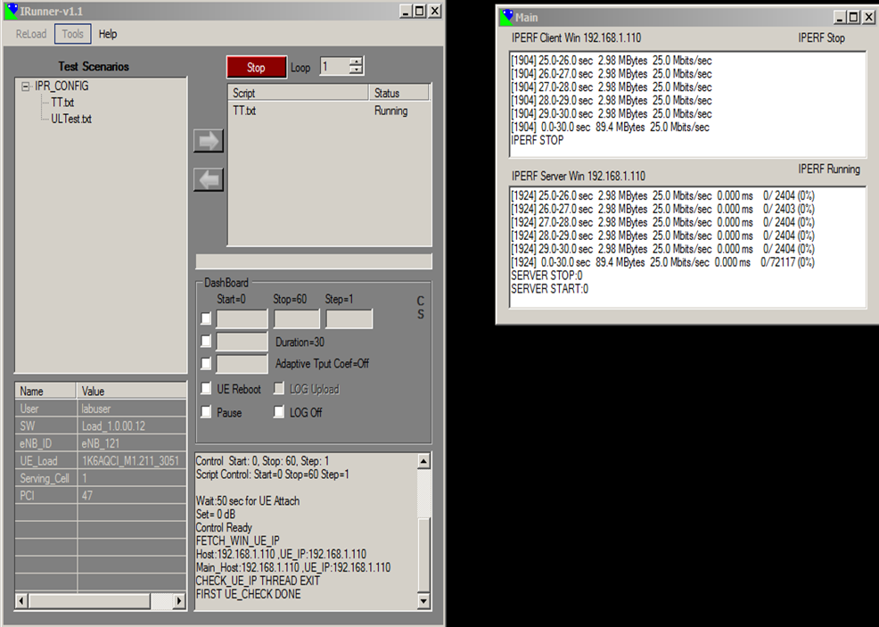
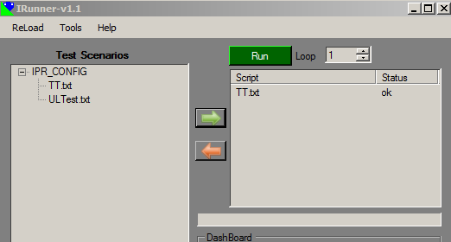




IPERF Suite – Usage of iRun.exe GUI
Navigate to TT.txt and Press
Logs collected in IPR_LOGS\.
Press to
Start test execution
Notes:
Frames with faded pictures and text
(Intermediate)
To reproduce the picture effects on this slide, do the following:
On the Home tab, in the Slides group, click Layout, and then click Blank.
On the Insert tab, in the Images group, click Picture.
In the Insert Picture dialog box, select a picture and then click Insert.
Under Picture Tools, on the Format tab, in the Size group, click the Size and Position dialog box launcher. In the Format Picture dialog box, resize or crop the image so that the height is set to 3” and the width is set to 3”. To crop the picture, click Crop in the left pane, and in the right pane, under Crop position, enter values into the Height, Width, Left, and Top boxes. To resize the picture, click Size in the left pane, and in the right pane, under Size and rotate, enter values into the Height and Width boxes.
Select the picture. On the Home tab, in the Clipboard group, click the arrow under Copy, and then click Duplicate.
Move the duplicate picture to an area below the original picture.
Select the original picture. Under Picture Tools, on the Format tab, in the Adjust group, click Color, and then, under Recolor, click Grayscale (first row, second option from the left).
Also in the Adjust group, click Corrections, and then click Picture Corrections Options. In the Format Picture dialog box, click Picture Corrections in the left pane, and then in the right pane, do the following:
In the Brightness box, enter 55%.
In the Contrast box, enter -70%.
Select the duplicate picture. Under Picture Tools, on the Format tab, in the Size group, click the arrow under Crop, point to Crop to Shape, and then under Basic Shapes click Frame (second row, fourth option from the left). Click and drag the yellow diamond adjustment handle to increase or decrease frame width.
On the Insert tab, in the Images group, click Picture.
In the Insert Picture dialog box, select another picture and then click Insert.
Select the new picture. Under Picture Tools, on the Format tab, in the Size group, click the Size and Position dialog box launcher. In the Format Picture dialog box, resize or crop the image so that the height is set to 3” and the width is set to 3”. To crop the picture, click Crop in the left pane, and in the right pane, under Crop position, enter values into the Height, Width, Left, and Top boxes.
To resize the picture, click Size in the left pane, and in the right pane, under Size and rotate, enter values into the Height and Width boxes.
Select the new picture. On the Home tab, in the Clipboard group, click the arrow under Copy, and then click Duplicate.
Move the duplicate picture to an area below the original picture.
Select the original picture. Under Picture Tools, on the Format tab, in the Adjust group, click Color, and then, under Recolor, click Grayscale (first row, second option from the left).
Also in the Adjust group, click Corrections, and then click Picture Corrections Options. In the Format Picture dialog box, click Picture Corrections in the left pane, and then in the right pane, do the following:
In the Brightness box, enter 55%.
In the Contrast box, enter -70%.
Select the duplicate picture. Under Picture Tools, on the Format tab, in the Size group, click the arrow under Crop, point to Crop to Shape, and then under Basic Shapes click Frame (second row, fourth option from the left). Click and drag the yellow diamond adjustment handle to make the frame width the same as the first one.
Press and hold SHIFT and select both frames. On the Home tab, in the Drawing group, click Shape Effects, Point to Bevel, and then click 3-D Options. In the Format Shape dialog box, click 3-D Format in the left pane, and then do the following in the right pane under Bevel:
Click the button next to Top, and then under Bevel click Circle (first row, first option from the left).
Next to Top, in the Width box, enter 6 pt.
Next to Top, in the Height box, enter 6 pt.
Also in the Format Shape dialog box, click Shadow in the left pane, and then do the following in the right pane:
Click the button next to Presets, and then under Outer click Offset Bottom (first row, second option from the left).
In the Blur box, enter 30 pt.
In the Distance box, enter 18 pt.
Press and hold SHIFT and select one of the frames and the corresponding grayscale picture. On the Home tab, in the Drawing group, click Arrange, and then do the following to position the frame directly on top of the grayscale picture:
Point to Align, and then click Align Selected Objects.
Point to Align, and then click Align Center.
Point to Align, and then click Align Middle.
Click Group.
Repeat step 14 with the other frame and corresponding grayscale picture.
Select each group and drag them so they are next to each other at the desired position on the slide.
Press and hold SHIFT and select both groups. On the Home tab, in the Drawing group, click Arrange, point to Align, and then click Align Middle.
To reproduce the text effects on this slide, do the following:
On the Insert tab, in the Text group, click Text Box, and then on the slide, drag to draw the text box.
Enter text in the text box, select the text, and then on the Home tab, in the Font group, select Franklin Gothic Medium Cond from the Font list and then enter 30 in the Font Size box.
On the Home tab, in the Paragraph group, click Center to center the text on the slide.
Under Drawing Tools, on the Format tab, in the WordArt Styles group, click the arrow next to Text Fill, and then under Theme Colors click White, Background 1, Darker 50% (sixth row, first option from the left).
On the slide, drag the text box to position it inside one of the frames.
Repeat steps 1-5 to create text for the other frame.
To reproduce the horizontal line effects on this slide, do the following:
On the Home tab, in the Drawing group, click Shapes, and then under Lines click Line (first option from the left).
Press and hold SHIFT, and then on the slide, drag to draw a straight, horizontal line.
Select the line. Under Drawing Tools, on the Format tab, in the Size group, in the Shape Width box, enter 10”.
On the Home tab, in the bottom right corner of the Drawing group, click the Format Shape dialog box launcher. In the Format Shape dialog box, click Line Color in the left pane, and then do the following in the right pane:
Select Solid line.
Click the button next to Color, and then under Theme Colors click White, Background 1, Darker 35% (fifth row, first option from the left).
Also in the Format Shape dialog box, click Line Style in the left pane, and then in the right pane, in the Width box, enter 0.75 pt.
On the Home tab, in the Clipboard group, click the arrow under Copy, and then click Duplicate.
Press and hold SHIFT and select both lines on the slide.
On the Home tab, in the Drawing group, click Arrange, and then click Send to Back.
Drag both lines so that they are positioned behind the pictures and frames.
On the Home tab, in the Drawing group, click Arrange, point to Align, and then do the following:
Click Align to Slide.
Click Align Center.
To reproduce the background on this slide, do the following:
On the Design tab, in the Background group, click the arrow next to Background Styles, and click Style 5 (second row, first option from the left). (Note: If this action is taken in a PowerPoint presentation containing more than one slide, the background style will be applied to all of the slides.)

Slide 8
IPERF Suite – Notes
IPERF Suite supports single IPERF session only.
IPERF Suite supports DL-UDP, DL-TCP, UL-UDP, UL-TCP.
IPERF Suite++ supports multiple IPERF sessions from multiple Hosts.
IPERF Suite questions, comments, wish list: tttower@comcast.net
IPERF Suite supports Log upload to dedicated Server using FTP.
IPERF Suite download: www.mantascode.com/Tools
IPERF tool download: https://iperf.fr/
Notes:
Frames with faded pictures and text
(Intermediate)
To reproduce the picture effects on this slide, do the following:
On the Home tab, in the Slides group, click Layout, and then click Blank.
On the Insert tab, in the Images group, click Picture.
In the Insert Picture dialog box, select a picture and then click Insert.
Under Picture Tools, on the Format tab, in the Size group, click the Size and Position dialog box launcher. In the Format Picture dialog box, resize or crop the image so that the height is set to 3” and the width is set to 3”. To crop the picture, click Crop in the left pane, and in the right pane, under Crop position, enter values into the Height, Width, Left, and Top boxes. To resize the picture, click Size in the left pane, and in the right pane, under Size and rotate, enter values into the Height and Width boxes.
Select the picture. On the Home tab, in the Clipboard group, click the arrow under Copy, and then click Duplicate.
Move the duplicate picture to an area below the original picture.
Select the original picture. Under Picture Tools, on the Format tab, in the Adjust group, click Color, and then, under Recolor, click Grayscale (first row, second option from the left).
Also in the Adjust group, click Corrections, and then click Picture Corrections Options. In the Format Picture dialog box, click Picture Corrections in the left pane, and then in the right pane, do the following:
In the Brightness box, enter 55%.
In the Contrast box, enter -70%.
Select the duplicate picture. Under Picture Tools, on the Format tab, in the Size group, click the arrow under Crop, point to Crop to Shape, and then under Basic Shapes click Frame (second row, fourth option from the left). Click and drag the yellow diamond adjustment handle to increase or decrease frame width.
On the Insert tab, in the Images group, click Picture.
In the Insert Picture dialog box, select another picture and then click Insert.
Select the new picture. Under Picture Tools, on the Format tab, in the Size group, click the Size and Position dialog box launcher. In the Format Picture dialog box, resize or crop the image so that the height is set to 3” and the width is set to 3”. To crop the picture, click Crop in the left pane, and in the right pane, under Crop position, enter values into the Height, Width, Left, and Top boxes.
To resize the picture, click Size in the left pane, and in the right pane, under Size and rotate, enter values into the Height and Width boxes.
Select the new picture. On the Home tab, in the Clipboard group, click the arrow under Copy, and then click Duplicate.
Move the duplicate picture to an area below the original picture.
Select the original picture. Under Picture Tools, on the Format tab, in the Adjust group, click Color, and then, under Recolor, click Grayscale (first row, second option from the left).
Also in the Adjust group, click Corrections, and then click Picture Corrections Options. In the Format Picture dialog box, click Picture Corrections in the left pane, and then in the right pane, do the following:
In the Brightness box, enter 55%.
In the Contrast box, enter -70%.
Select the duplicate picture. Under Picture Tools, on the Format tab, in the Size group, click the arrow under Crop, point to Crop to Shape, and then under Basic Shapes click Frame (second row, fourth option from the left). Click and drag the yellow diamond adjustment handle to make the frame width the same as the first one.
Press and hold SHIFT and select both frames. On the Home tab, in the Drawing group, click Shape Effects, Point to Bevel, and then click 3-D Options. In the Format Shape dialog box, click 3-D Format in the left pane, and then do the following in the right pane under Bevel:
Click the button next to Top, and then under Bevel click Circle (first row, first option from the left).
Next to Top, in the Width box, enter 6 pt.
Next to Top, in the Height box, enter 6 pt.
Also in the Format Shape dialog box, click Shadow in the left pane, and then do the following in the right pane:
Click the button next to Presets, and then under Outer click Offset Bottom (first row, second option from the left).
In the Blur box, enter 30 pt.
In the Distance box, enter 18 pt.
Press and hold SHIFT and select one of the frames and the corresponding grayscale picture. On the Home tab, in the Drawing group, click Arrange, and then do the following to position the frame directly on top of the grayscale picture:
Point to Align, and then click Align Selected Objects.
Point to Align, and then click Align Center.
Point to Align, and then click Align Middle.
Click Group.
Repeat step 14 with the other frame and corresponding grayscale picture.
Select each group and drag them so they are next to each other at the desired position on the slide.
Press and hold SHIFT and select both groups. On the Home tab, in the Drawing group, click Arrange, point to Align, and then click Align Middle.
To reproduce the text effects on this slide, do the following:
On the Insert tab, in the Text group, click Text Box, and then on the slide, drag to draw the text box.
Enter text in the text box, select the text, and then on the Home tab, in the Font group, select Franklin Gothic Medium Cond from the Font list and then enter 30 in the Font Size box.
On the Home tab, in the Paragraph group, click Center to center the text on the slide.
Under Drawing Tools, on the Format tab, in the WordArt Styles group, click the arrow next to Text Fill, and then under Theme Colors click White, Background 1, Darker 50% (sixth row, first option from the left).
On the slide, drag the text box to position it inside one of the frames.
Repeat steps 1-5 to create text for the other frame.
To reproduce the horizontal line effects on this slide, do the following:
On the Home tab, in the Drawing group, click Shapes, and then under Lines click Line (first option from the left).
Press and hold SHIFT, and then on the slide, drag to draw a straight, horizontal line.
Select the line. Under Drawing Tools, on the Format tab, in the Size group, in the Shape Width box, enter 10”.
On the Home tab, in the bottom right corner of the Drawing group, click the Format Shape dialog box launcher. In the Format Shape dialog box, click Line Color in the left pane, and then do the following in the right pane:
Select Solid line.
Click the button next to Color, and then under Theme Colors click White, Background 1, Darker 35% (fifth row, first option from the left).
Also in the Format Shape dialog box, click Line Style in the left pane, and then in the right pane, in the Width box, enter 0.75 pt.
On the Home tab, in the Clipboard group, click the arrow under Copy, and then click Duplicate.
Press and hold SHIFT and select both lines on the slide.
On the Home tab, in the Drawing group, click Arrange, and then click Send to Back.
Drag both lines so that they are positioned behind the pictures and frames.
On the Home tab, in the Drawing group, click Arrange, point to Align, and then do the following:
Click Align to Slide.
Click Align Center.
To reproduce the background on this slide, do the following:
On the Design tab, in the Background group, click the arrow next to Background Styles, and click Style 5 (second row, first option from the left). (Note: If this action is taken in a PowerPoint presentation containing more than one slide, the background style will be applied to all of the slides.)

Slide 9
IPERF Suite – Enjoy!
Notes:
Frames with faded pictures and text
(Intermediate)
To reproduce the picture effects on this slide, do the following:
On the Home tab, in the Slides group, click Layout, and then click Blank.
On the Insert tab, in the Images group, click Picture.
In the Insert Picture dialog box, select a picture and then click Insert.
Under Picture Tools, on the Format tab, in the Size group, click the Size and Position dialog box launcher. In the Format Picture dialog box, resize or crop the image so that the height is set to 3” and the width is set to 3”. To crop the picture, click Crop in the left pane, and in the right pane, under Crop position, enter values into the Height, Width, Left, and Top boxes. To resize the picture, click Size in the left pane, and in the right pane, under Size and rotate, enter values into the Height and Width boxes.
Select the picture. On the Home tab, in the Clipboard group, click the arrow under Copy, and then click Duplicate.
Move the duplicate picture to an area below the original picture.
Select the original picture. Under Picture Tools, on the Format tab, in the Adjust group, click Color, and then, under Recolor, click Grayscale (first row, second option from the left).
Also in the Adjust group, click Corrections, and then click Picture Corrections Options. In the Format Picture dialog box, click Picture Corrections in the left pane, and then in the right pane, do the following:
In the Brightness box, enter 55%.
In the Contrast box, enter -70%.
Select the duplicate picture. Under Picture Tools, on the Format tab, in the Size group, click the arrow under Crop, point to Crop to Shape, and then under Basic Shapes click Frame (second row, fourth option from the left). Click and drag the yellow diamond adjustment handle to increase or decrease frame width.
On the Insert tab, in the Images group, click Picture.
In the Insert Picture dialog box, select another picture and then click Insert.
Select the new picture. Under Picture Tools, on the Format tab, in the Size group, click the Size and Position dialog box launcher. In the Format Picture dialog box, resize or crop the image so that the height is set to 3” and the width is set to 3”. To crop the picture, click Crop in the left pane, and in the right pane, under Crop position, enter values into the Height, Width, Left, and Top boxes.
To resize the picture, click Size in the left pane, and in the right pane, under Size and rotate, enter values into the Height and Width boxes.
Select the new picture. On the Home tab, in the Clipboard group, click the arrow under Copy, and then click Duplicate.
Move the duplicate picture to an area below the original picture.
Select the original picture. Under Picture Tools, on the Format tab, in the Adjust group, click Color, and then, under Recolor, click Grayscale (first row, second option from the left).
Also in the Adjust group, click Corrections, and then click Picture Corrections Options. In the Format Picture dialog box, click Picture Corrections in the left pane, and then in the right pane, do the following:
In the Brightness box, enter 55%.
In the Contrast box, enter -70%.
Select the duplicate picture. Under Picture Tools, on the Format tab, in the Size group, click the arrow under Crop, point to Crop to Shape, and then under Basic Shapes click Frame (second row, fourth option from the left). Click and drag the yellow diamond adjustment handle to make the frame width the same as the first one.
Press and hold SHIFT and select both frames. On the Home tab, in the Drawing group, click Shape Effects, Point to Bevel, and then click 3-D Options. In the Format Shape dialog box, click 3-D Format in the left pane, and then do the following in the right pane under Bevel:
Click the button next to Top, and then under Bevel click Circle (first row, first option from the left).
Next to Top, in the Width box, enter 6 pt.
Next to Top, in the Height box, enter 6 pt.
Also in the Format Shape dialog box, click Shadow in the left pane, and then do the following in the right pane:
Click the button next to Presets, and then under Outer click Offset Bottom (first row, second option from the left).
In the Blur box, enter 30 pt.
In the Distance box, enter 18 pt.
Press and hold SHIFT and select one of the frames and the corresponding grayscale picture. On the Home tab, in the Drawing group, click Arrange, and then do the following to position the frame directly on top of the grayscale picture:
Point to Align, and then click Align Selected Objects.
Point to Align, and then click Align Center.
Point to Align, and then click Align Middle.
Click Group.
Repeat step 14 with the other frame and corresponding grayscale picture.
Select each group and drag them so they are next to each other at the desired position on the slide.
Press and hold SHIFT and select both groups. On the Home tab, in the Drawing group, click Arrange, point to Align, and then click Align Middle.
To reproduce the text effects on this slide, do the following:
On the Insert tab, in the Text group, click Text Box, and then on the slide, drag to draw the text box.
Enter text in the text box, select the text, and then on the Home tab, in the Font group, select Franklin Gothic Medium Cond from the Font list and then enter 30 in the Font Size box.
On the Home tab, in the Paragraph group, click Center to center the text on the slide.
Under Drawing Tools, on the Format tab, in the WordArt Styles group, click the arrow next to Text Fill, and then under Theme Colors click White, Background 1, Darker 50% (sixth row, first option from the left).
On the slide, drag the text box to position it inside one of the frames.
Repeat steps 1-5 to create text for the other frame.
To reproduce the horizontal line effects on this slide, do the following:
On the Home tab, in the Drawing group, click Shapes, and then under Lines click Line (first option from the left).
Press and hold SHIFT, and then on the slide, drag to draw a straight, horizontal line.
Select the line. Under Drawing Tools, on the Format tab, in the Size group, in the Shape Width box, enter 10”.
On the Home tab, in the bottom right corner of the Drawing group, click the Format Shape dialog box launcher. In the Format Shape dialog box, click Line Color in the left pane, and then do the following in the right pane:
Select Solid line.
Click the button next to Color, and then under Theme Colors click White, Background 1, Darker 35% (fifth row, first option from the left).
Also in the Format Shape dialog box, click Line Style in the left pane, and then in the right pane, in the Width box, enter 0.75 pt.
On the Home tab, in the Clipboard group, click the arrow under Copy, and then click Duplicate.
Press and hold SHIFT and select both lines on the slide.
On the Home tab, in the Drawing group, click Arrange, and then click Send to Back.
Drag both lines so that they are positioned behind the pictures and frames.
On the Home tab, in the Drawing group, click Arrange, point to Align, and then do the following:
Click Align to Slide.
Click Align Center.
To reproduce the background on this slide, do the following:
On the Design tab, in the Background group, click the arrow next to Background Styles, and click Style 5 (second row, first option from the left). (Note: If this action is taken in a PowerPoint presentation containing more than one slide, the background style will be applied to all of the slides.)

